Slide 1
DevOps
@llaslo
peter@llaslo.guru
Bridging the Gap Between Development and Delivery
Peter Karaganis

Slide 2
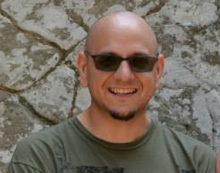
About Me
@llaslo
peter@llaslo.guru
Sr. Enterprise Architect - Six Flags
Coding professionally since 1995
Industry Experience:
Entertainment
Amusement Park
Media
Printing
Aerospace
Consulting
Office Products
I am…
A Pragmatist
Passionate…
About Innovation
About Technology
About Improving Processes
About Solving Problems
About Seeing My Code Make a Difference
Geek
Peter Karaganis
Notes:
Discuss my Dev Background (VB6, .NET, C#, Objective-C, Java, etc.) and my NET Ops background
Pragmatic

Slide 3
What is DevOps?
“DevOps is all about working together in more open and efficient ways so teams can collaborate better and ship better performing code.” - New Relic
“DevOps is an approach based on lean and agile principles in which business owners and the development, operations, and quality assurance departments collaborate to deliver software in a continuous manner that enables the business to more quickly seize market opportunities and reduce the time to include customer feedback.” - Sanjeev Sharma & Bernie Coyne
Dev
QA
Dev
Ops
Operations

Slide 4
The Good ol’ Days (or were they)
“I don’t always test my code, but when I do, I test in production.”
Deployments were infrequent
Few 3rd Party Integrations
Local Development (developers all at one location)
Weak Security (simple username and password)
Notes:
Briefly talk about sneaker net deployments and other such methods

Slide 5
The Case For DevOps
Technical:
Faster delivery
More automation
Less human error
Better testing
Not only for the cloud
Business:
More time for adding value
More stable releases
Reduced deployment costs
Better user satisfaction
Notes:
Discuss why these are the pros and cons and briefly go into what they mean

Slide 6
“In most organizations, Dev and Ops have misaligned goals. Dev is measured by the number of new features. Ops is measured by 100% uptime. Question: What’s the best way to get 100% uptime? Answer: Don’t introduce any new features or make any changes.”
–The Best Lines From DevOps Days

Slide 7
The Dev-Ops Barrier
Dev is tasked with adding value through new features
Operations is tasked with maintaining 100% Uptime
These are two principles are at odds with each other
Development
Operations
Notes:
Talk about the gate issue

Slide 8
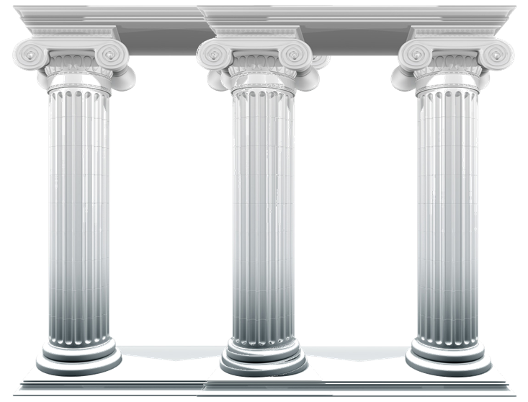
Key Tenets of DevOps
Pragmatic problem solving
Automate, automate, automate
Avoid silos
Develop trust between groups
Notes:
Brief overview of what each means
We’ll go into more detail in coming slides

Slide 9



Pragmatic Problem Solving
Problems
Identify Issues
Should I solve the issue at all?
Alternative Solutions:
Communication
Documentation
Problems I
can solve with code
Problems I should solve
with code
Notes:
Really go into pragmatism here

Slide 10
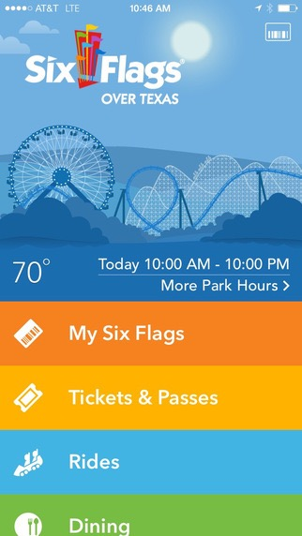
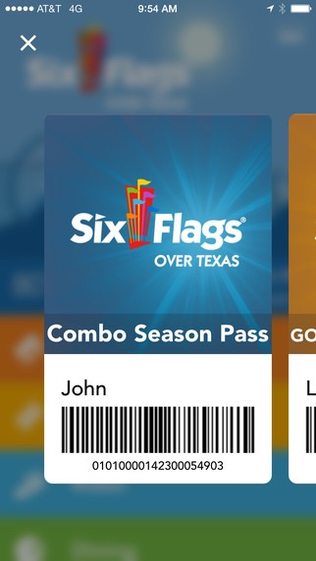
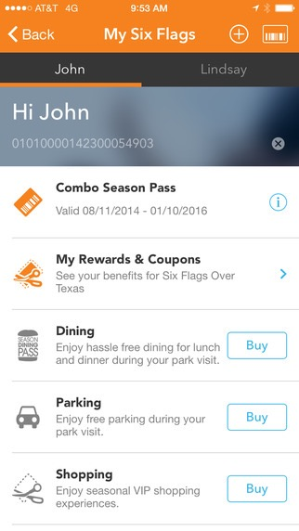
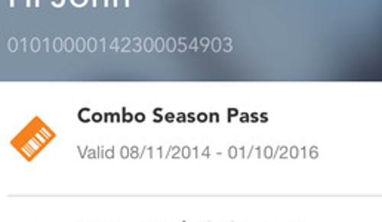
Pragmatic Problem Solving - Example
Notes:
Go into the details of this issue and why the “Solution” is pragmatic

Slide 11
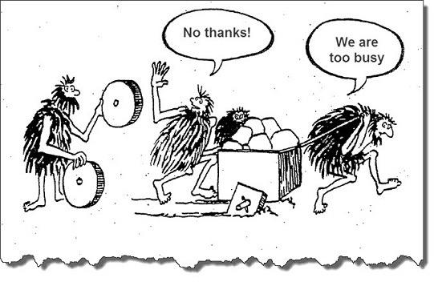
Automate, Automate, Automate
Reduces human error
Creates time
Repeatability leads to stability
Understand it before you automate it
If you can’t validate it, you can’t automate it
Test beyond the happy path
Notes:
Example: Data refresh

Slide 12
Avoid Silos
Don’t communicate only through tickets
“Developers can learn a lot from operations, and operations can learn a lot from developers.” - Paul Duvall, CTO, Stelligent
Create cross-functional teams
Stakeholders
Developers
QA
Operations
Notes:
Discuss the pitfalls here in some detail

Slide 13
Develop Trust Between Groups
Don’t gossip
Don’t throw stones
Open (non-emotional) communication is essential
Accept responsibility
Management buy-in is critical
“Lack of trust in an organization is really expensive. You can’t villianize others if you know their kids.”
- The Best Lines From DevOps Days
Notes:
Lets discuss trust in relationships, both personal & professional

Slide 14

DevOps @

Slide 15
About Six Flags
Worlds largest regional them park company
18 Parks across the United States, Canada, and Mexico
$1.2 Billion in Revenue as of 2015
2015 InformationWeek Elite 100
2016 CIO Top 100 Award
Notes:
Mention that 2015 numbers are not yet released

Slide 16
"We pride ourselves on innovation at every level, from our record-breaking rides and attractions to business solutions that create efficient, seamless park operations. Our leadership role in information technology serves as a strategic and brand differentiator for our company"
– Jim Reid-Anderson, Chairman, Six Flags Entertainment Company
Notes:
Read it

Slide 17
Technology Stack (not exhaustive)
.NET Framework
.NET Compact Framework
MSMQ
WCF
WPF
Web API
SOAP
Entity Framework
Windows CE
Telerik
Octopus Deploy
Slack
Coverity
Bitbucket
Jira
New Relic
Team City
CodeRush
Runscope
Swagger
VM Ware
Net App
Android
iOS
Notes:
Definitely not an exhaustive list. The real list would be at least 3x this list in size

Slide 18
Six Flags Code Metrics
Notes:
This is more to show the relative size of our most complex app compared to the rest of the code

Slide 19
Six Flags Code Metrics
87 Build Projects
227 Build Configuration
33 Octopus Deploys * 4 Environments
Deployments to 102 Servers

Slide 20
Deployment Barriers
PCI Compliance - Tier 1
SOX
Year-Round Park Operations
Complex Environment
No Inter-Park Communication (All inter-park messaging proxies through Data Center)
Global Ticketing
Service Oriented Architecture
3rd Party Vendor Integrations
Front Gate
E-Commerce
Point of sale
Mobile Devices
Disaster Recovery
Notes:
These are just a few high level barriers
Discuss why they are barriers at all

Slide 21
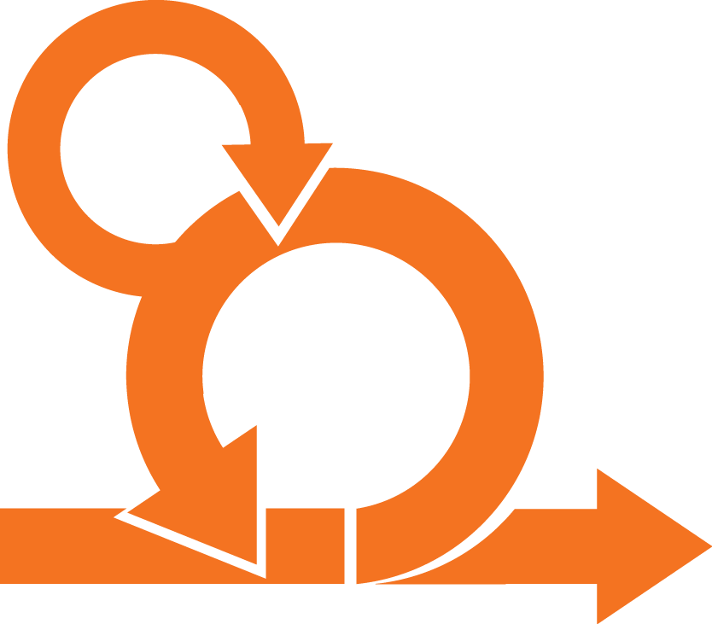
Our Methodology
Scrum
2-Week Sprint
Weekly Backlog Grooming
Daily Standup
Combined Team Demo / Retrospective
Early Stakeholder Feedback
Notes:
Brief overview of our process
stakeholder involvement is a big initiative in 2015

Slide 22

Development Flow
Merge
Code to Develop
Deploy To Dev
Pull Request -> Master
Merge Pull Request
CI Build Runs
Daily Build (0 based version)
Release Build (x based version)
Deploy To Production
Code Review
Coverity Analysis
Deploy To QA
Deploy to Stage
Notes:
Discuss that this is basically our flow, but simplified

Slide 23
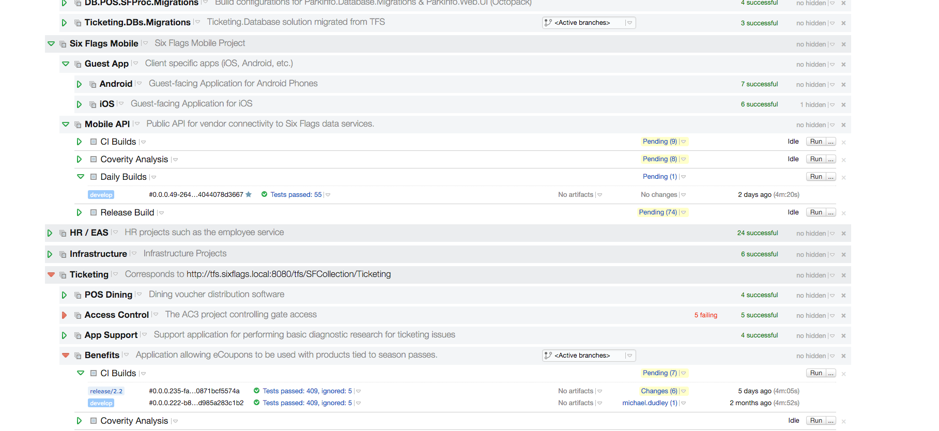
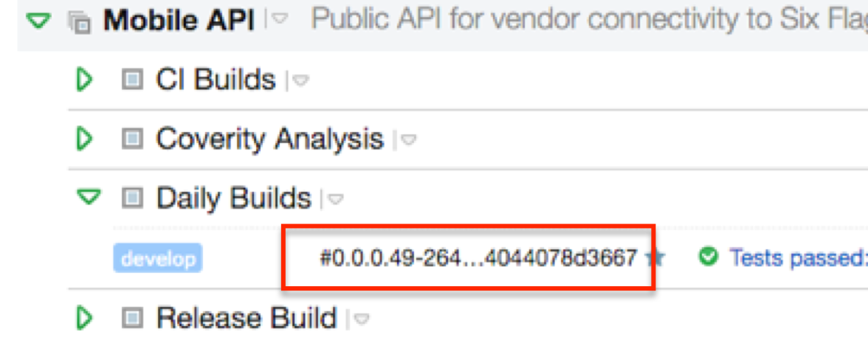
Development Flow
Notes:
Shows the 0-based build numbers used by the daily build. Also shows the 3 other build types

Slide 24
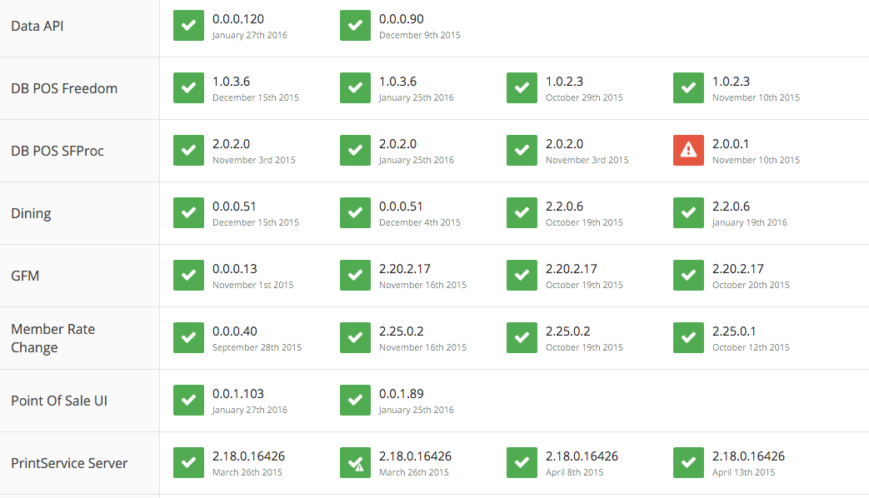
Development Flow
Notes:
Shows that 0-based goes to dev, x-based goes to QA+

Slide 25
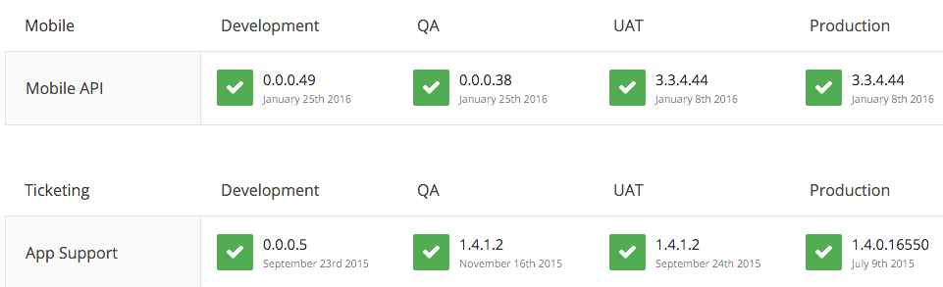
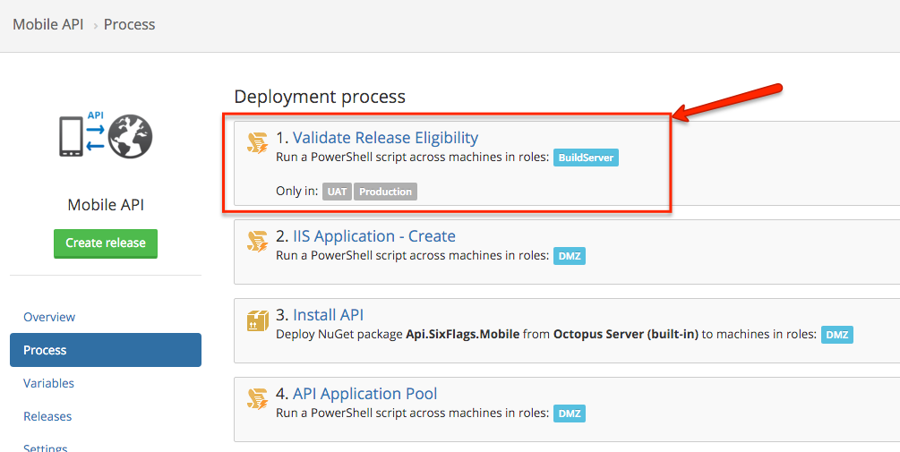
Automation Protection
Notes:
Shows that 0-based is gated to <= QA

Slide 26
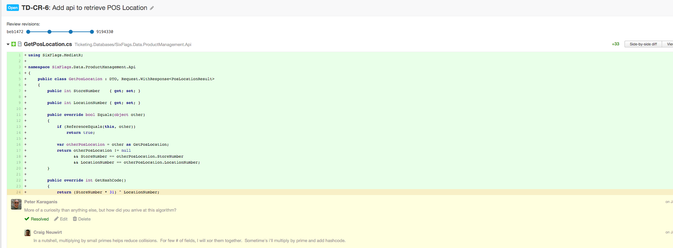
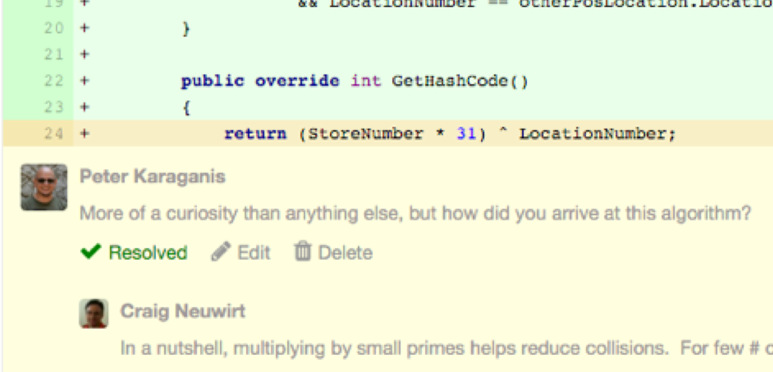
Code Review
Notes:
Shows Upsource

Slide 27
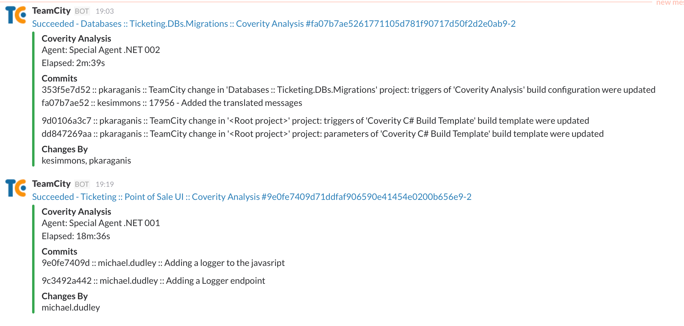
Tooling
Notes:
Example of tooling that helps

Slide 28
What we do well
High-quality code
Involve stakeholders early
Emphasize training
Embrace innovation (pragmatically)
Truly understand business requirements

Slide 29
Areas for Improvement
Better communication
More frequent releases
More frequent environment refresh
Better test automation
Improved cohesion with NetOps

Slide 30
Conclusion
Plan -> Do -> Check -> Act
Be pragmatic
Build inter-departmental trust
Automate as much as you can
Avoid failure, but embrace it
Constantly evaluate
Surround yourself with excellence
Dev
QA
Dev
Ops
Operations

Slide 31
Thank You!
@llaslo
peter@llaslo.guru
Peter Karaganis

